Slide 1


Slide 2
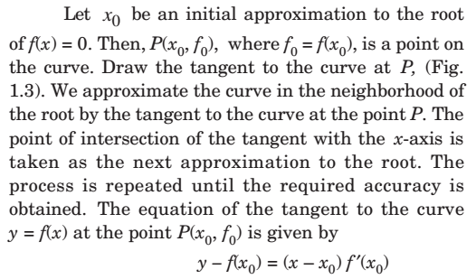
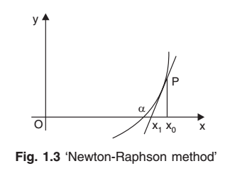

Numerical Methods
National University of Science and Technology, Islamabad

Slide 3








Numerical Methods
National University of Science and Technology, Islamabad

Slide 4
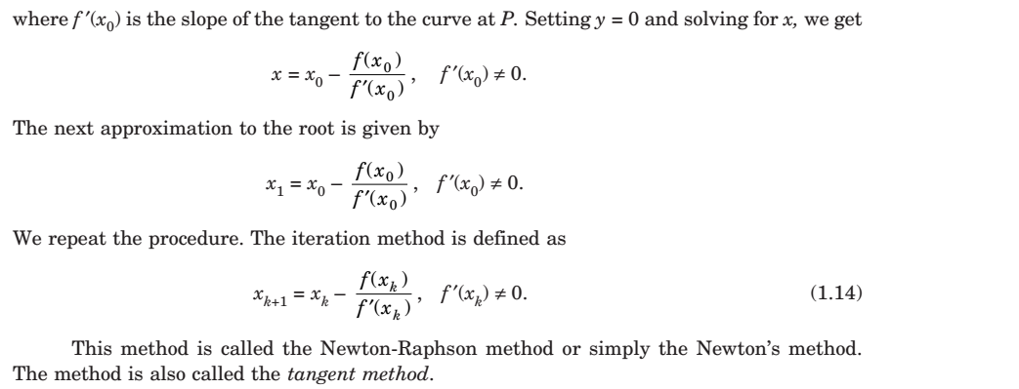
Numerical Methods
National University of Science and Technology, Islamabad

Slide 5
Numerical Methods
In each problem either number of iterations will be mentioned or find root correct to
n decimal point will be mentioned. If both or not mentioned then perform 6 iterations
by default and fix your calculator for 6 decimal places.
Note: In correct up to n decimal points, take at most n+1 digits in every iterations
and evaluation of function and derivative at x.
This Criteria will be used in all problems solving by any numerical method and also
Follow it in your quizzes, assignments, MSE and ESE.
National University of Science and Technology, Islamabad

Slide 6
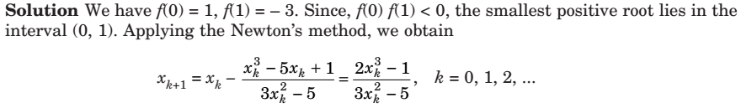
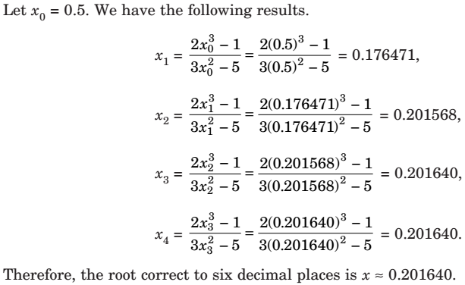
Numerical Methods
National University of Science and Technology, Islamabad

Slide 7
Numerical Methods
National University of Science and Technology, Islamabad

Slide 8
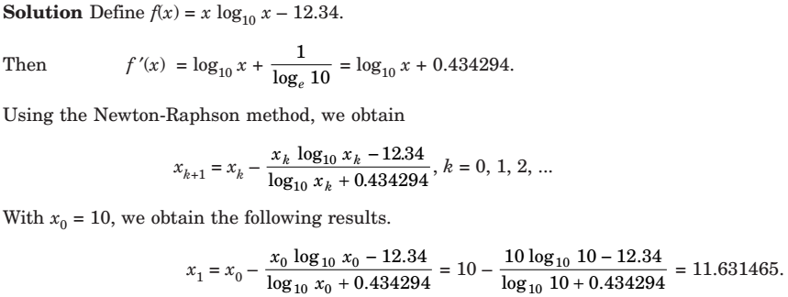
Numerical Methods
National University of Science and Technology, Islamabad

Slide 9
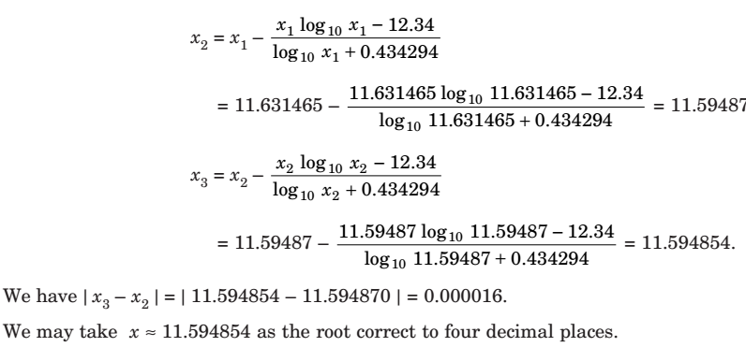
Numerical Methods
National University of Science and Technology, Islamabad

Slide 10
Numerical Methods
National University of Science and Technology, Islamabad

Slide 11
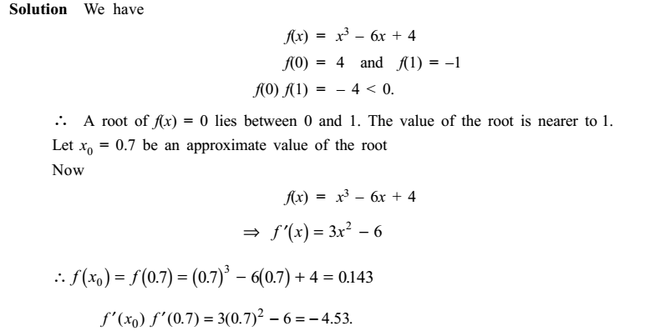
Numerical Methods
National University of Science and Technology, Islamabad

Slide 12
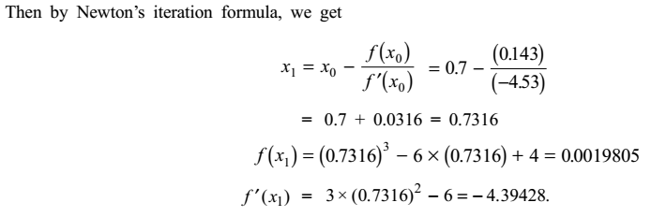
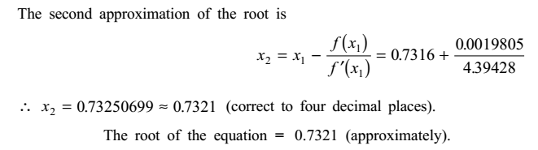
Numerical Methods
National University of Science and Technology, Islamabad

Slide 13
Numerical Methods
National University of Science and Technology, Islamabad

Slide 14
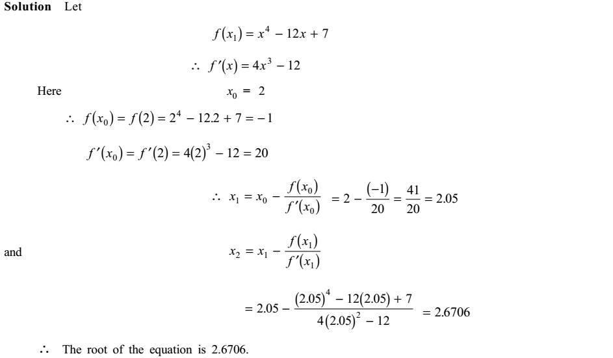
Numerical Methods
National University of Science and Technology, Islamabad

Slide 15
Numerical Methods
National University of Science and Technology, Islamabad

Slide 16
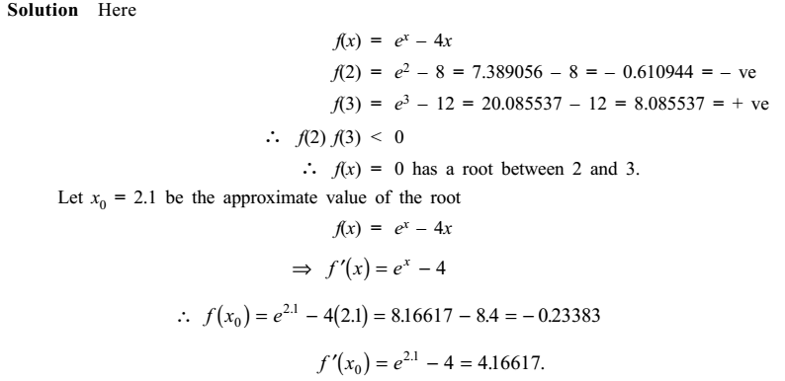
Numerical Methods
National University of Science and Technology, Islamabad

Slide 17
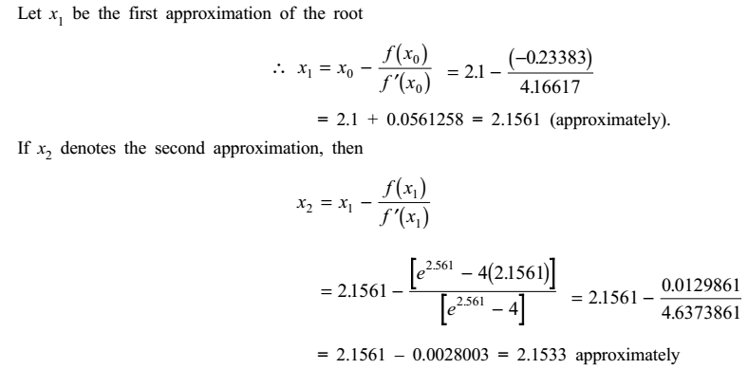
Numerical Methods
National University of Science and Technology, Islamabad

Slide 18
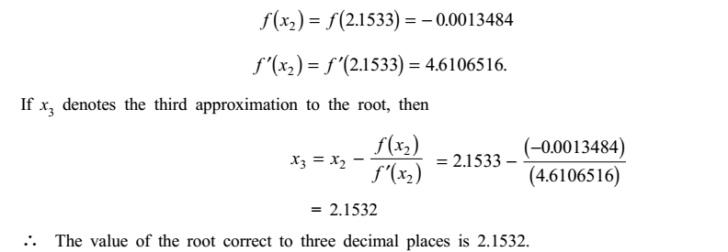

Numerical Methods
Quaid-i-Azam University
Department of Mathematics
National University of Science and Technology, Islamabad

Slide 19
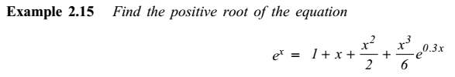
Numerical Methods
Quaid-i-Azam University
Department of Mathematics
National University of Science and Technology, Islamabad

Slide 20
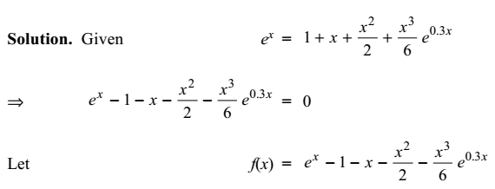
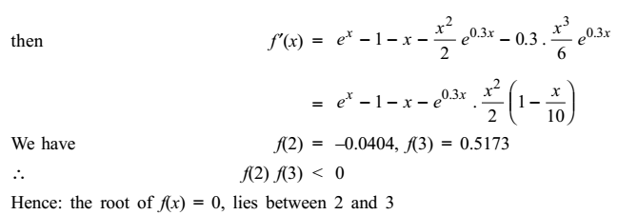
Numerical Methods
Quaid-i-Azam University
Department of Mathematics
National University of Science and Technology, Islamabad

Slide 21
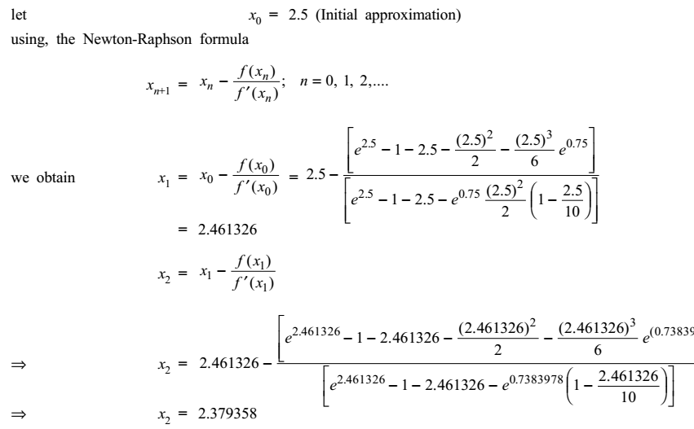
Numerical Methods
Quaid-i-Azam University
Department of Mathematics
National University of Science and Technology, Islamabad

Slide 22
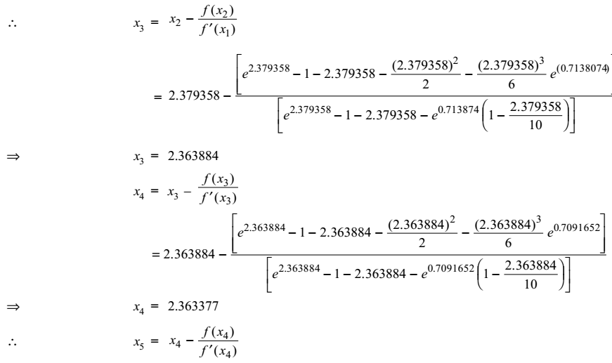
Numerical Methods
Quaid-i-Azam University
Department of Mathematics
National University of Science and Technology, Islamabad

Slide 23
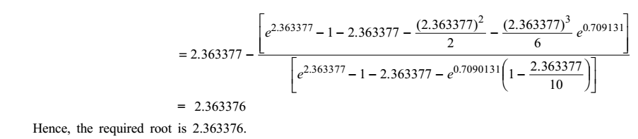
Numerical Methods
Quaid-i-Azam University
Department of Mathematics
National University of Science and Technology, Islamabad

Slide 24
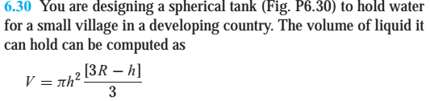
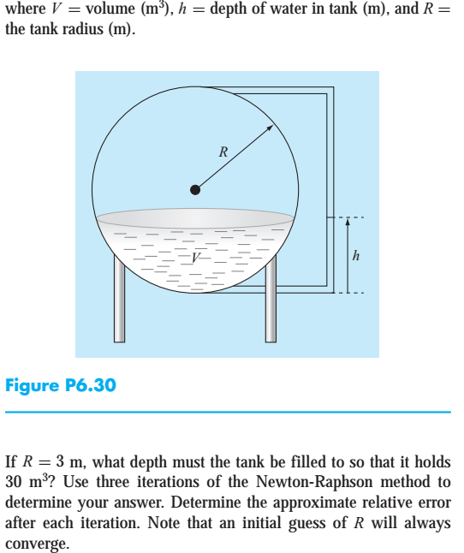
Numerical Methods
Quaid-i-Azam University
Department of Mathematics
National University of Science and Technology, Islamabad

Slide 25
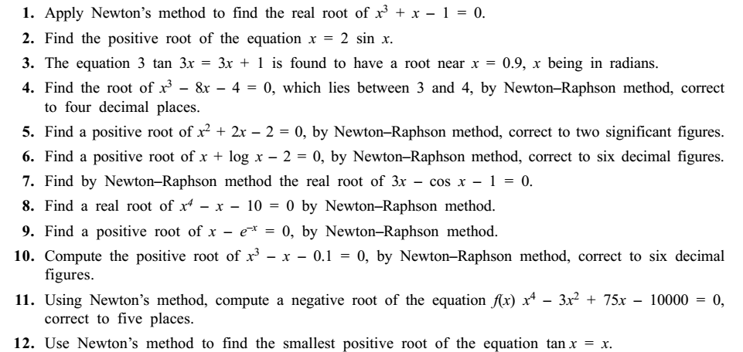
Numerical Methods
Quaid-i-Azam University
Department of Mathematics
National University of Science and Technology, Islamabad

